Slide 1


DATA ANALYSIS

Slide 2


Today's agenda
Project recap
Problem
The Analytics team
Process
Insights
Summary

Slide 3

Social Buzz is a fast growing technology unicorn that need to adapt quickly to it's global scale. Accenture has begun a 3 month POC focusing on these tasks:
An audit of Social Buzz's big data practice
Recommendations for a successful IPO
Analysis to find Social Buzz's top 5 most popular categories of content
Project Recap

Slide 4


Problem
Over 100000 posts per day
36,500,000 pieces of content
per year!
But how to capitalize on it when there is so much?
Analysis to find Social Buzz's top 5 most popular categories of content

Slide 5



ANDREW FLEMING
Chief Technology Architect
The Analytics team
MARCUS ROMPTON
Senior Principal
SIDDHARTH
Data Analyst

Slide 6
Process
1
Data Understanding
2
Data Cleaning
3
Data Modelling
4
Data Analysis
5
Data Visualization

Slide 7

Insights
16
1050
JANUARY
UNIQUE
CATEGORIES
POSITIVE REACTIONS TO "ANIMAL" POSTS
MONTH WITH
MOST POSTS

Slide 8
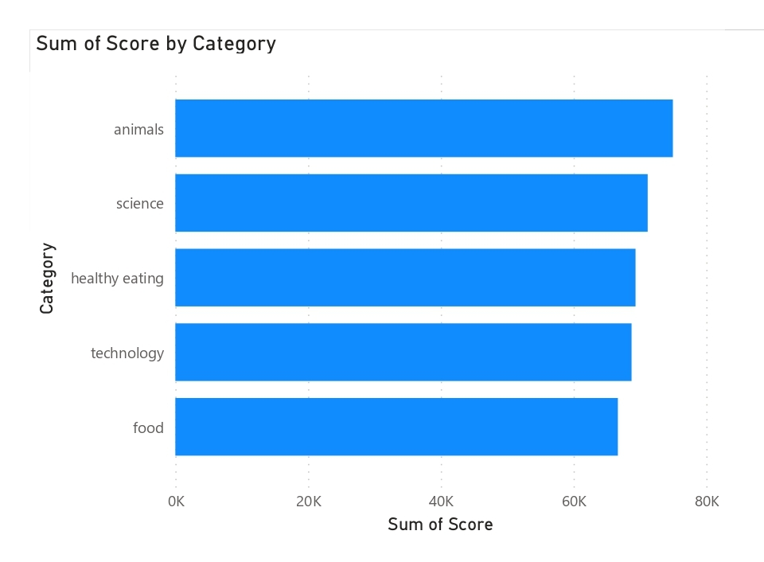

Slide 9
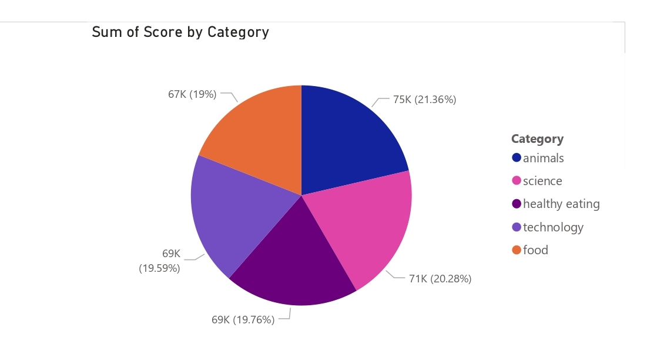

Slide 10
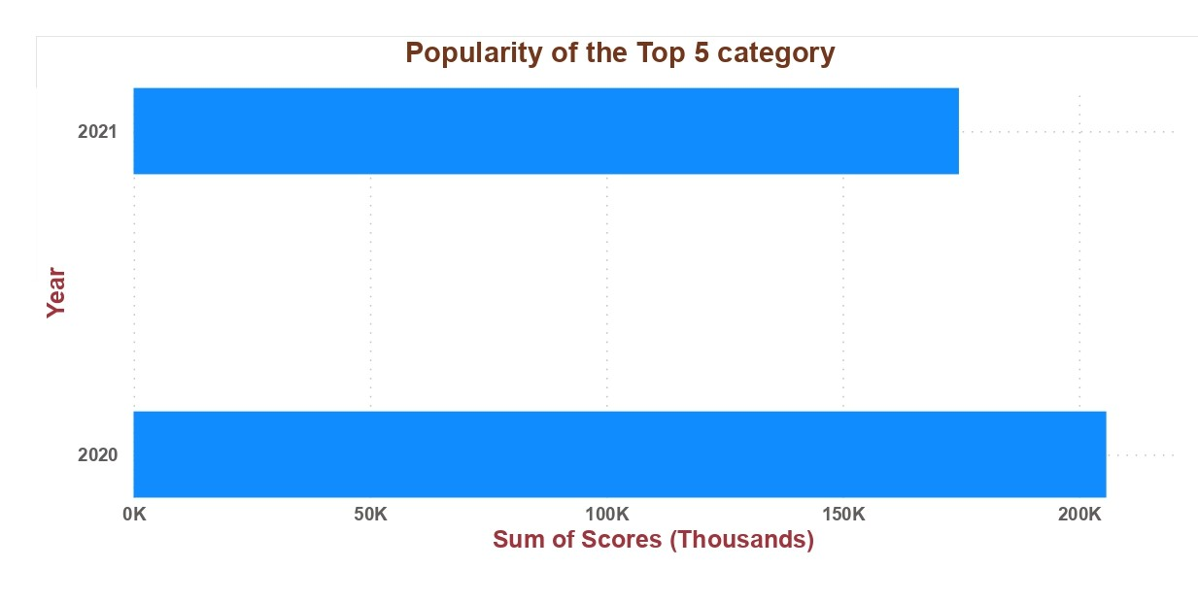

Slide 11

ANALYSIS
Animals and science are the two most popular categories of content, showing that people enjoy "real-life" and "factual" content the most.
INSIGHT
Summary
Though you have received more positive reactions for your posts than negative and neutral reactions, the popularity has decreased for the year 2021 when compared to 2020. It reflects people have change in their priority for their content rapidly. It indicates that you have to keep updating your content with respect to people’s sentiments.
NEXT STEPS
This ad-hoc analysis is insightful, but it's time to take this analysis into large scale production for real-time understanding of your business. We can show you how to do this.

Slide 12

Thank you!
ANY QUESTIONS?

